Slide 1
Introducing F# Through Unit Testing
A quick intro to F#
Notes:
Interested in F# and functional programming but have a tough time finding a spot for it in your projects? This talk will discuss how to introduce F# to your dev team through unit testing. We'll talk about the value F# code can add to your tests, documentation, and even mocking!

Slide 2
Who I am
Christopher Brown, Dev Lead at Parametric Portfolio Associates.
15+ Year Programmer and F# enthusiast

Slide 3
Who you are
You're a .NET developer, likely using C# or VB.NET for most of your backend code.
You may write unit tests for your code, (hopefully lots), but if not, you're interested in doing so.
You're interested in F#, but aren't fluent; you may not be entirely sure you could read it if you saw it.

Slide 4
What is this about
Introduce you to F# and to the tools required to code in F#, and doing so within the context of writing unit tests for your production code.

Slide 5
What should you come away with?
Appreciation for F# as a succinct, correct, easy to reason about language.

Slide 6
Why do we unit test code?

Slide 7
Why do we unit test code?
To prove that it works as expected, both immediately and over the time when we’ve lost context of what it is we wrote.

Slide 8
Why do we unit test code?
To prove that it works as expected, both immediately and over the time when we’ve lost context of what it is we wrote.
Help avoid application regression.

Slide 9
Why do we unit test code?
To prove that it works as expected, both immediately and over the time when we’ve lost context of what it is we wrote.
Help avoid application regression.
Quick feedback on refactored code.

Slide 10
Why do we unit test code?
To prove that it works as expected, both immediately and over the time when we’ve lost context of what it is we wrote.
Help avoid application regression.
Quick feedback on refactored code.
Act as a form of documentation for what code should do.

Slide 11
Why do we unit test code?
To prove that it works as expected, both immediately and over the time when we’ve lost context of what it is we wrote.
Help avoid application regression.
Quick feedback on refactored code.
Act as a form of documentation for what code should do.
?

Slide 12
What’s painful when we unit test code?

Slide 13
What’s painful when we unit test code?
All the extra code/work required for fairly simplistic (and sometimes tough to justify!) tests.

Slide 14
What’s painful when we unit test code?
All the extra code/work required for fairly simplistic (and sometimes tough to justify!) tests.
When failing tests break, is it our code under test that’s at fault, or the test code?

Slide 15
What’s painful when we unit test code?
All the extra code/work required for fairly simplistic (and sometimes tough to justify!) tests.
When failing tests break, is it our code under test that’s at fault, or the test code?
Mocking frameworks

Slide 16
What’s painful when we unit test code?
All the extra code/work required for fairly simplistic (and sometimes tough to justify!) tests.
When failing tests break, is it our code under test that’s at fault, or the test code?
Mocking frameworks
?

Slide 17
How does F# help?

Slide 18
How does F# help?
It’s succinct and expressive
Write less code for the same/more functionality.
Inferred types keep code terse and readable. Method names read more naturally.

Slide 19
How does F# help?
It’s succinct and expressive
It’s functional, and expects immutability
Tests written functionally won’t overwrite state on each other.
Tests become more stable, and more reliable.

Slide 20
How does F# help?
It’s succinct and expressive
It’s functional, and expects immutability
It makes object creation / interface mocking is dirt simple.
Features: Implementing interfaces with anonymous objects! Less Frameworks = Less Dependency pain.

Slide 21
So let’s dive in!

Slide 22
Indenting and whitespace
Unlike many languages, whitespace MATTERS when writing in F# code.
let function argument = let function-scoped = 42 let another-scoped = 21 … let outer-scoped = “super star”
NOTE: 4 spaces imply a variable within the scope of the “function”.
Notes:
I find whitespace in C# to be very inconsistent. Properties without backing fields should be on one line. Linq statements have a funky structure, but not when in method groups.
Whitespace in F# allows me to understand the scope of something.

Slide 23
Indenting and whitespace
Unlike many languages, whitespace MATTERS when writing in F# code.
let function argument = let subfunction arg = let deeply-scoped = ... let outer = subfunction “Jay Z”
Again, 4 spaces deeper show a variable within the scope of the “subfunction”.
Notes:
Or secondarily so

Slide 24
Indenting and whitespace
Unlike many languages, whitespace MATTERS when writing in F# code.
let function argument = let subfunction arg = let deeply-scoped = ... let outer = subfunction “Jay Z”
And “subfunction” is callable within the scope of the parent.

Slide 25
Indenting and whitespace
Unlike many languages, whitespace MATTERS when writing in F# code.
let function argument = let subfunction arg = let deeply-scoped = ... let outer = subfunction “Jay Z”
let broken = subfunction “No can do”
But ‘subfunction’ falls outside that scope, so is no longer callable.

Slide 26
What the heck is “let”
The let keyword is an assignment operator. It gives names to things.
Like values or results of functions. or functions themselves.
let fortyTwo = 42
let twentyEight = times_4 7
let squareAndAdd6To val = val * val + 6

Slide 27
Branching with ‘if’
Like many other programming languages, simple branching is done with an ‘if’ statement. Examples:
let greet name = let hr = System.DateTime.Now.Hour if hr < 12 then sprintf “Good morning %s!” name elif hr < 17 then sprintf “Good afternoon %s!” name else sprintf “Good evening, %s!” name

Slide 28
Match expressions!
let greet name = match System.DateTime.Now.Hour with | hr when hr < 12 -> sprintf “Good morning %s!” name | hr when hr < 17 -> sprintf “Good afternoon %s!” name | _ -> sprintf “Good evening, %s!” name
Notes:
The thing being evaluated.

Slide 29
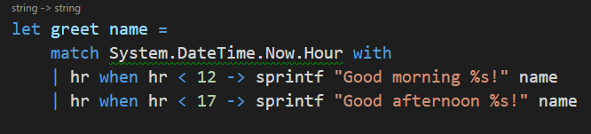
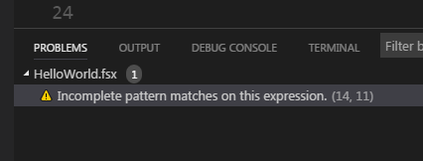
Match expressions have (better) compiler help.
Example:
Notes:
The compiler can get fancy, knowing we are missing edge cases, bugs.

Slide 30
And can even match against structure.
let length list = let rec loop acc = match acc with | head::tail -> 1 + loop (tail) | [] -> 0
loop list

Slide 31
Tuples, triples, etc.
A tuple is a great way to quickly associate two or more pieces of data together, or triples.
let myTriple = (5, [“this”;”is a list”], 1.41) let item1, item2, item3 = myTriple
Notes:
Deconstruct, just as you think you would.

Slide 32
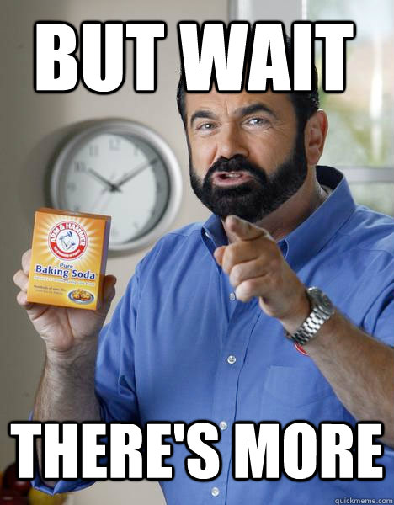
Simple record types Lists, sequences, arrays, and more! Union Types Messaging and the Actor Model Computation Expressions Type Providers Monads / Burritos

Slide 33
Show and Tell
“The guilded rose.”
and a few tests I stole from production

Slide 34
Questions?

Slide 35
Thank you!
https://github.com/cmbrown1598/codecampfs/ @cmbrown1598

